Slide 1

South Africa
Technology Day
Breathe Digital

Slide 2
Reducing energy costs within schools using solar and geyser interventions
Input
Process
Output
Parameters obtained from school:
Utility bills
School type and tariff
School location
Available Budget
Building specifications
Number of geysers
Energy usage forecasting
Solar system optimisation
Intelligent geyser control
Energy usage forecast
Maximum monthly demand forecast
IRR and utilisation rate of various solar system sizes
School’s energy and monthly energy bill savings using intelligent geyser control

Slide 3
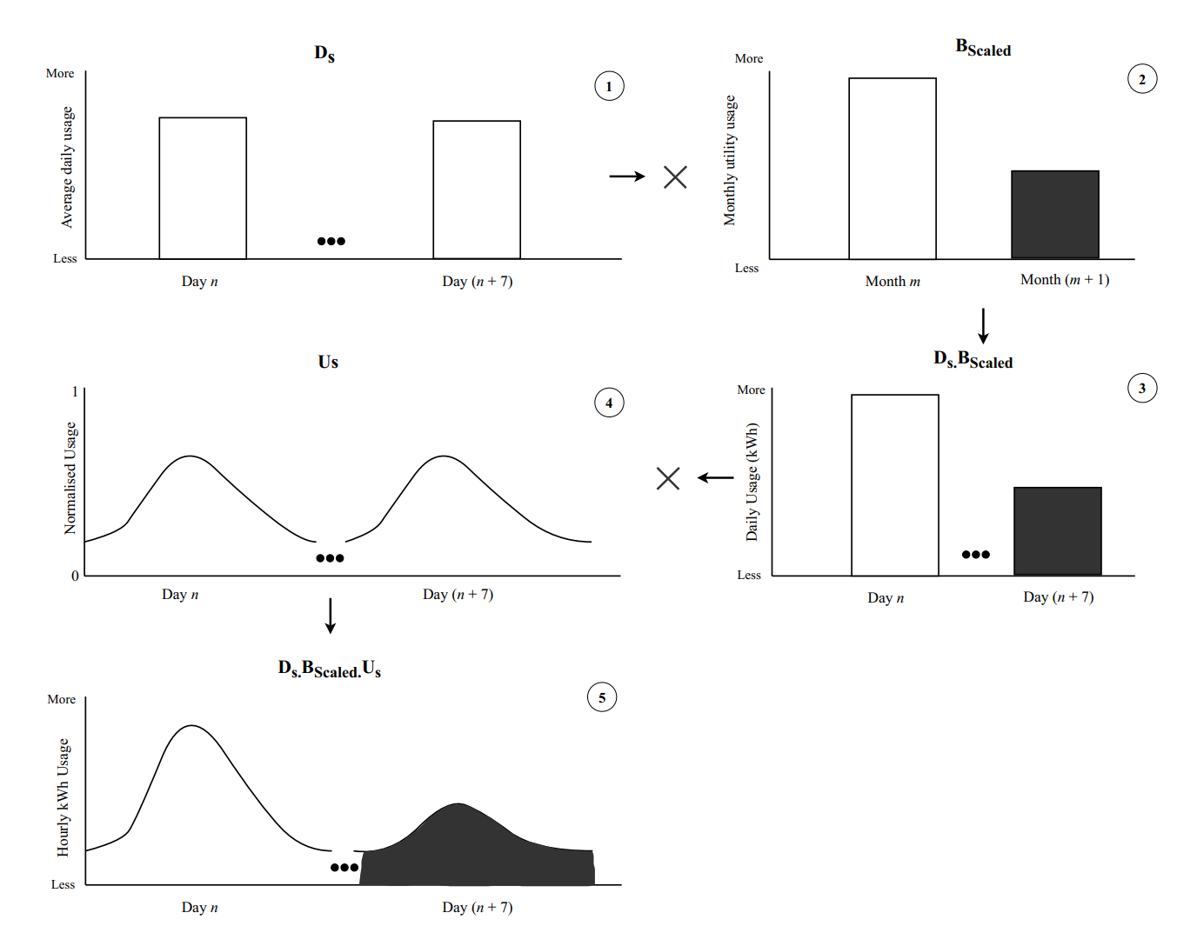
Energy usage forecasting

Slide 4
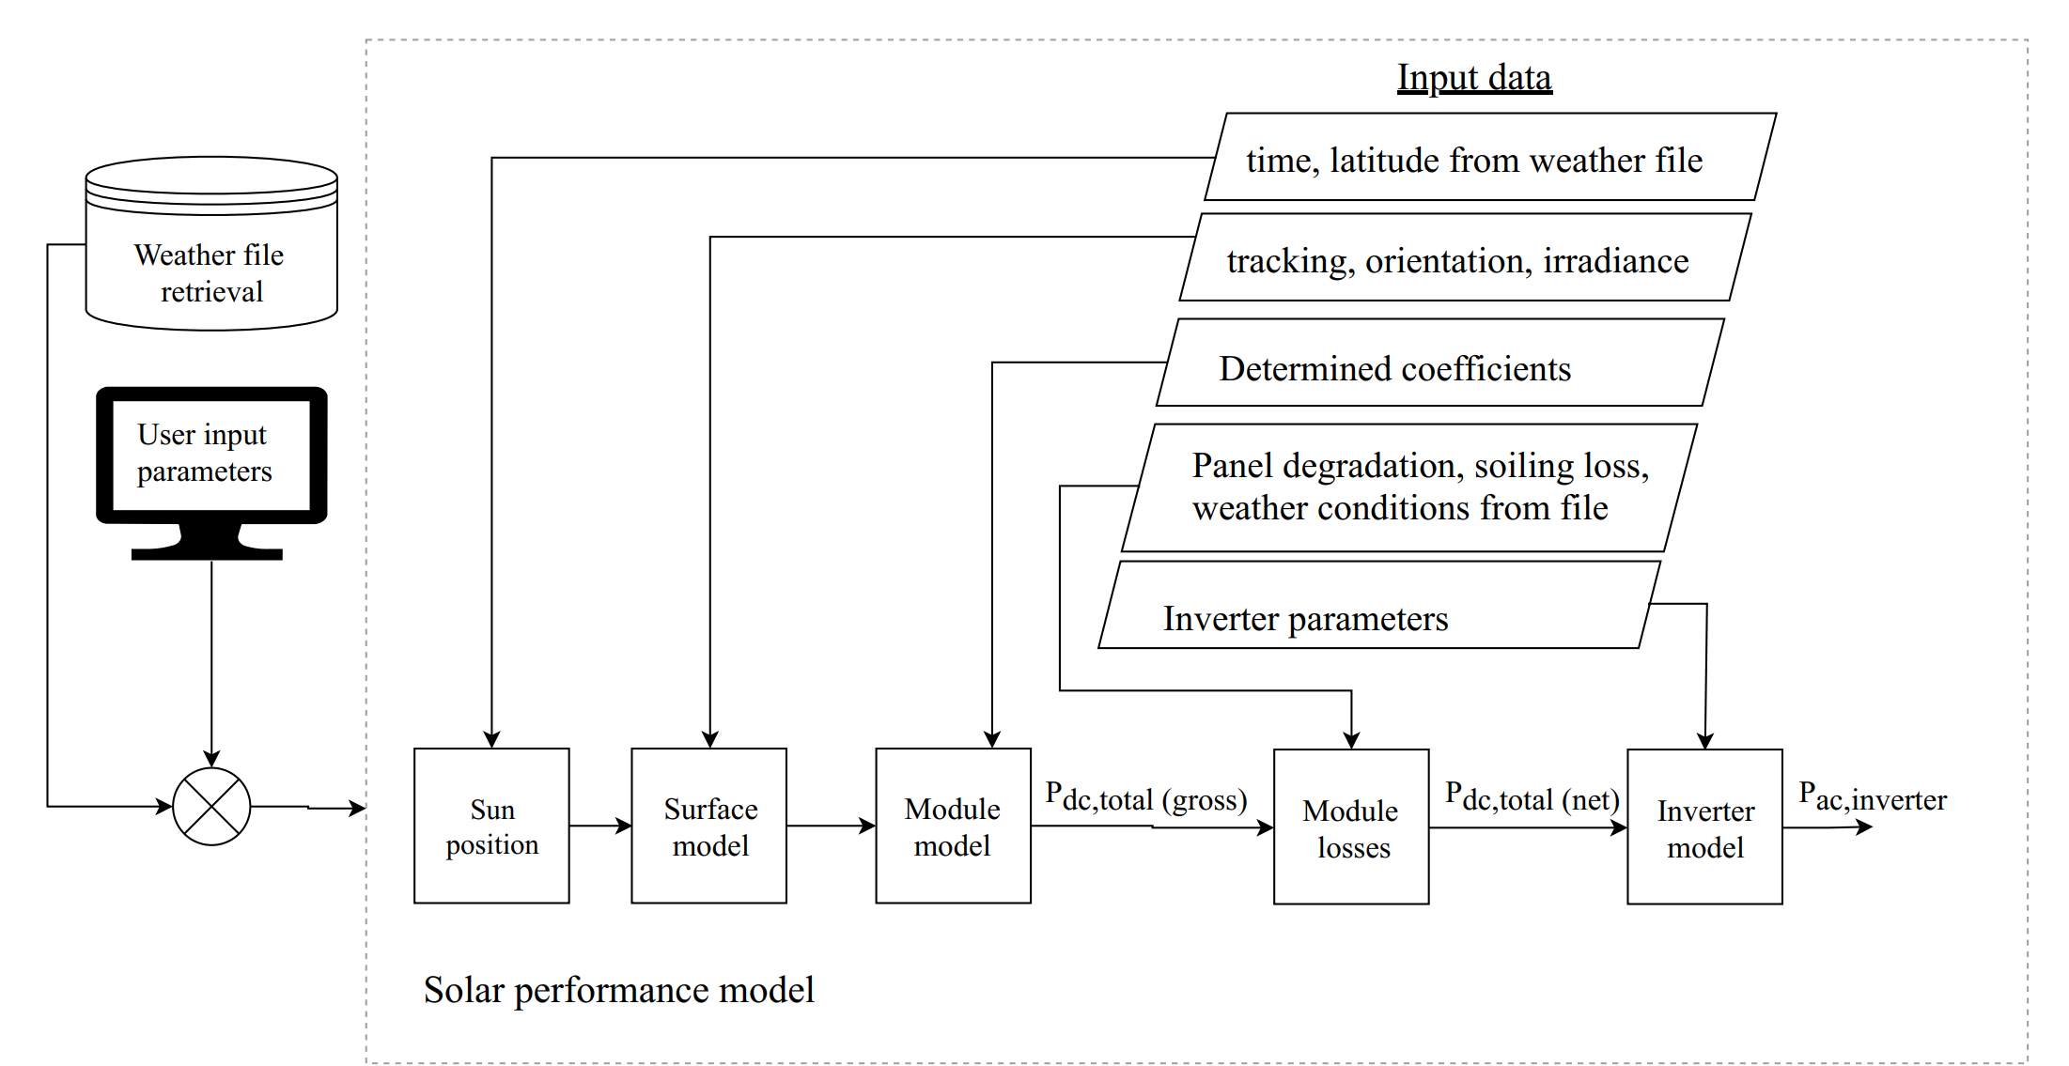
Solar system optimisation

Slide 5
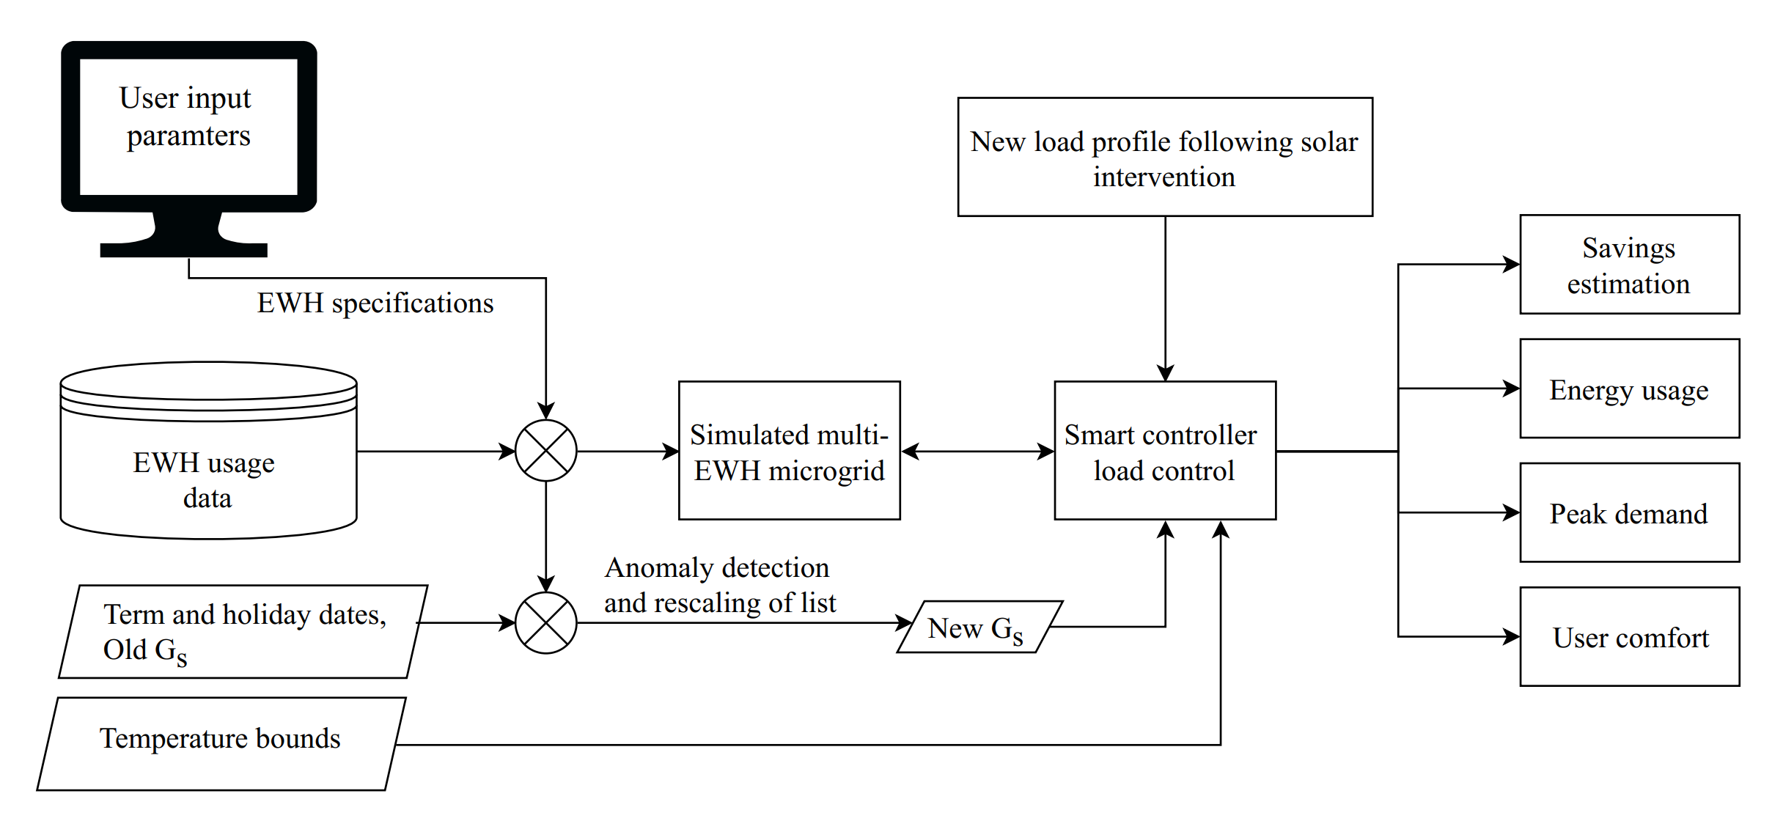
Intelligent geyser control

Slide 6
Results
Forecasting:
Energy usage forecasting accuracy -> 95.8 %
Maximum monthly demand forecasting accuracy -> 94.1%
Solar system optimisation:
Can determine IRR and utilisation of the system’s generating capacity for various solar system sizes.
Intelligent geyser control: (Evaluated school uses 160 Mwh yearly, solar system size was 37.4kW)
Smart-schedule control with solar dumping was able to reduce the evaluated school’s monthly utility bill by an average of 23.2%.
24.8% for bi-thermal control + solar dumping.
26.7% for demand limiting + bit-thermal + solar dumping.
System payback period of 6 years.

Slide 8
South Africa
Technology Day
Breathe Digital

Slide 9
NB-IoT Performance
Latency, Energy, and UE/NW Behaviour Evaluation

Slide 10
Agenda
What is NB-IoT and why?
Performance Characteristics
Discussion and Recommendations

Slide 11
What is NB-IoT and why?
NB-IoT is a strong contender set to refarm the sun-setting 2G/GPRS being turned off around the world. ~20dB gain improvement over 2G/GPRS
Lower ICASA licensing costs than LTE Cat-M. NB-IoT only requires a single channel of 200kHz bandwidth, whilst LTE Cat-M offers VoIP and uses 1 MHz of spectrum
NB-IoT is bidirectional. SigFox and LoRaWAN is essentially only uplink centric which is useful for simple metering applications.
NB-IoT has eDRX and PSM power saving modes. It can listen periodically to the eNodeB for paging occasions with intervals extended up to 43.69 minutes meaning latency-tolerant data on-demand.
Energy consumption is variable and this study investigates deeper.

Slide 12
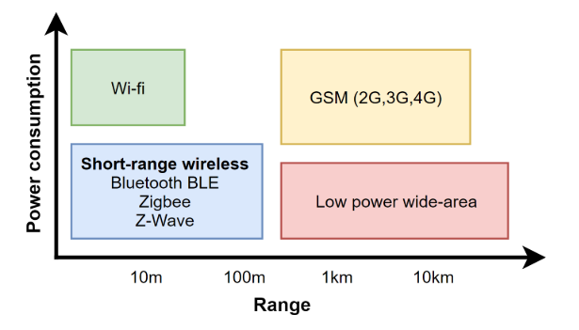
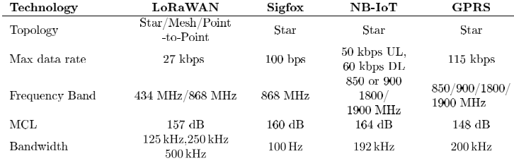
Low Power Wide Area Networks
NB-IoT is bidirectional, and has similar range to SigFox

Slide 13






Performance characteristics
Tests were performed for:
MTN
Ericsson, ZTE
Vodacom
Huawei, Nokia
Tests measure predominantly latency and energy consumption metrics for different network conditions.

Slide 14
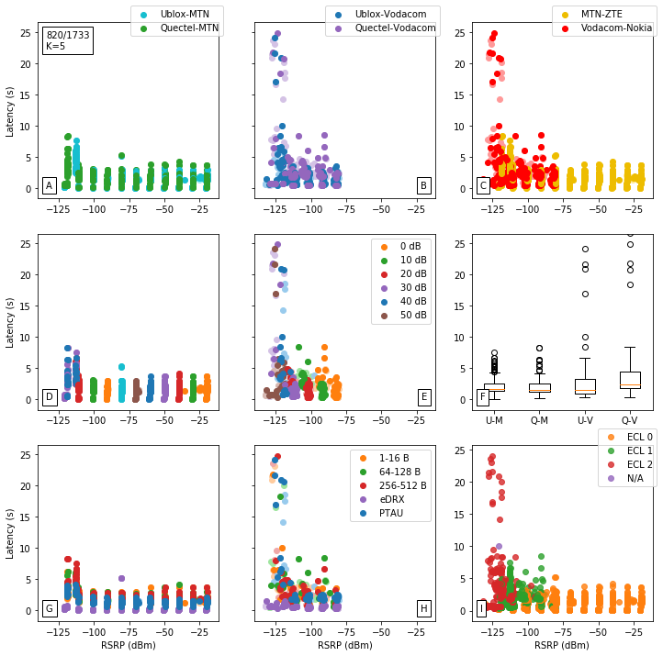
Latency
Vodacom-Huawei network has outliers above 10 seconds for ECL 2 and up to 150 seconds.
MTN-Ericsson shows superior characteristics in Test Lab

Slide 15
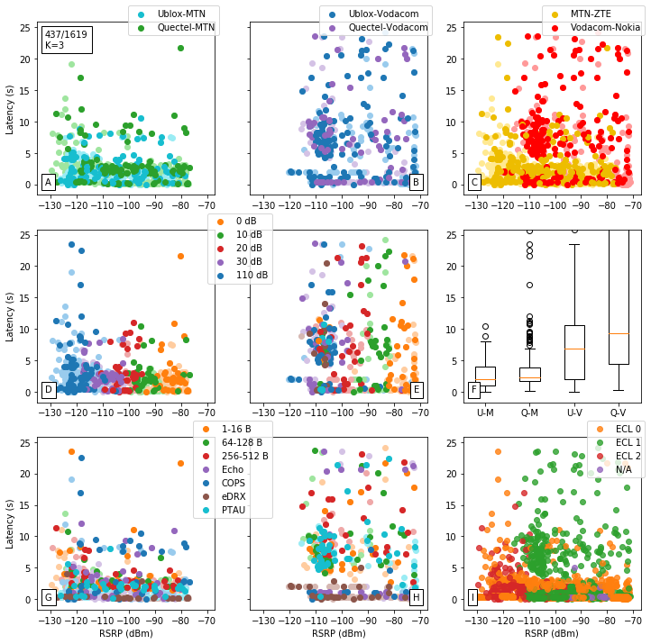
Latency
Vodacom-Nokia network has outliers above 10 seconds for ECL 1 and up to 250 seconds.
MTN-ZTE shows satisfactory performance in Stellenbosch

Slide 16
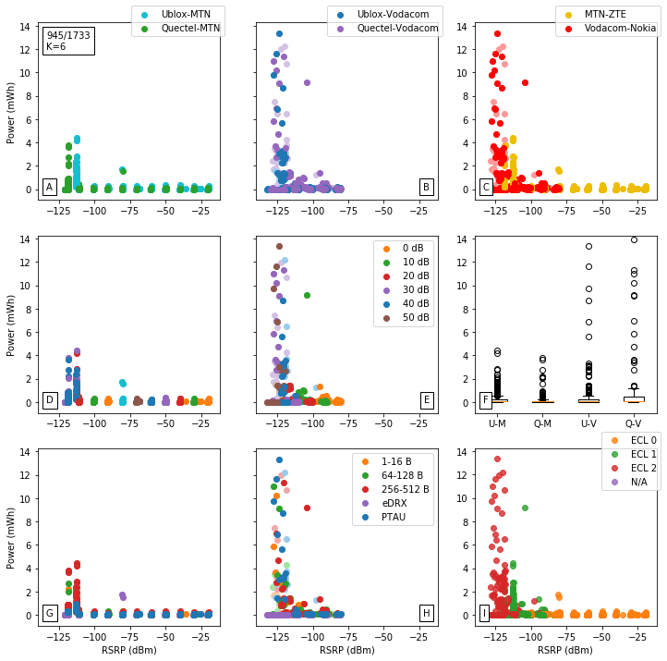
Energy
Vodacom-Huawei network has outliers above 4 mWh for ECL 2 and up to 50 mWh.
MTN-Ericsson shows satisfactory characteristics in Test Lab
Similar means 100-200 uWh.

Slide 17
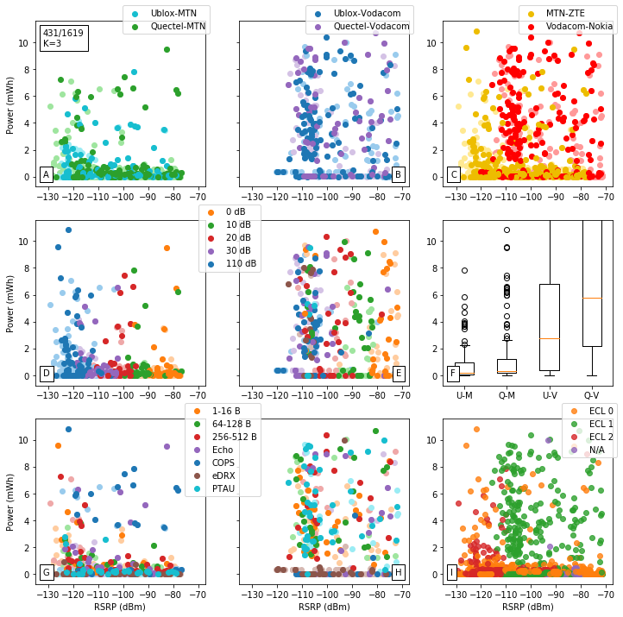
Energy
Vodacom-Nokia network has outliers above 4 mWh for ECL 1 and up to 50 mWh.
MTN-ZTE shows average characteristics in Stellenbosch, whilst Vodacom-Nokia shows poorly.
Means around 200-500 uWh.

Slide 18
Discussion and Recommendations
Ranking:
1. MTN-Ericsson
2. Vodacom-Huawei
3. MTN-ZTE
4. Vodacom-Nokia

Slide 19

Thank you

